Slide 1

NYC Relocation
By the “GHOSTBUSTERS311” (tOny, Faris, Ani, Brian)

Slide 2
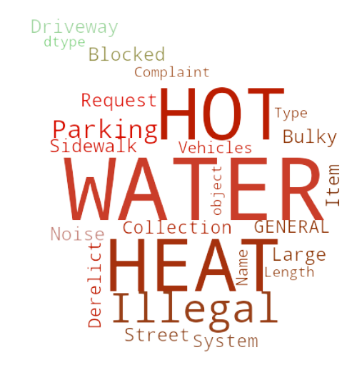
Information Gathering
What are you looking for?

Slide 3


Basic Criteria
Traditional
Quality Of Life:
Quiet neighborhood
Reliable utilities (water & heat)
Nice roads (not many potholes)
Parking access
Safety
Pedestrian accessibility
Price range: $550k -$750k
Location: Any of the 5 boroughs in NYC
House or Apartment: either
Beds & Baths: 2bd and 1ba (min)
Other needs:
Near a good schools
Near a park
Near emergency services (hospital)
Churches
Non- Traditional
Notes:
NYPD Complaints: not enough data and we would need to analyze
If you want absolute quiet you will need to up your price range to a high rise in Manhattan

Slide 4

311 (How can we help?)
What: NYC 311’s mission is to provide the public with quick, easy access to all New York City government services and information while offering the best customer service. NON-EMERGENCY HELP DESK
When: 24/7/365
Who: residents, businesses & visitors to NYC
How: Text, phone, online, other (Twitter, Skype)
We use the 311 data to help identify our client’s most ideal location

Slide 5
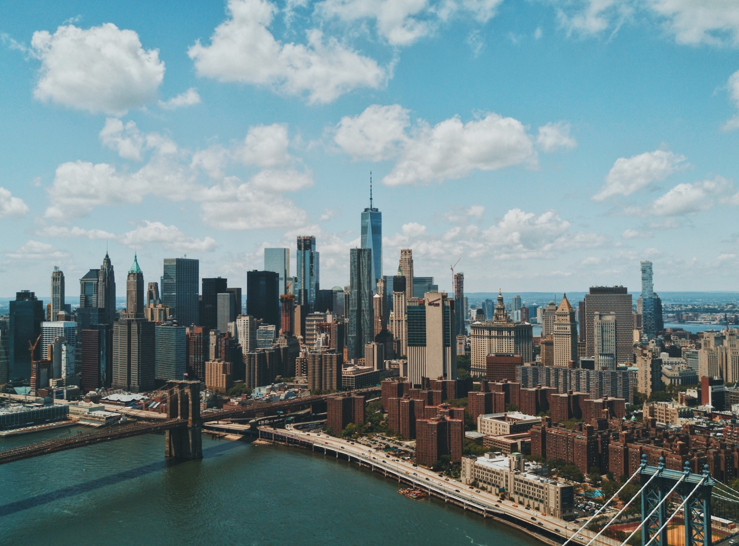
Filtering the Locations
What is the best fit?

Slide 6
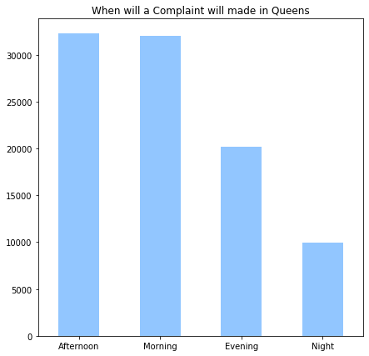
What does the data tell us about: Noise
When compared to Brooklyn, Queens’ lower noise complaint percentage results in 3000 less occurrences
Notes:
Staten Island has a furthest distance from the city
Queens 7498 noise complaints
Manhattan 7400 noise complaints
Brooklyn 10,000 noise complaints

Slide 7
What does the data tell us about Utilities
Queens is hands down the best place for reliable heat and hot water

Slide 8
What does the data tell us about Blocked driveways
Queens overall is no worse than Brooklyn
Notes:
Queens No Access 5656
Queens Partial Access 2643
Brooklyn No Access 5511
Brooklyn Partial Access 1934

Slide 9
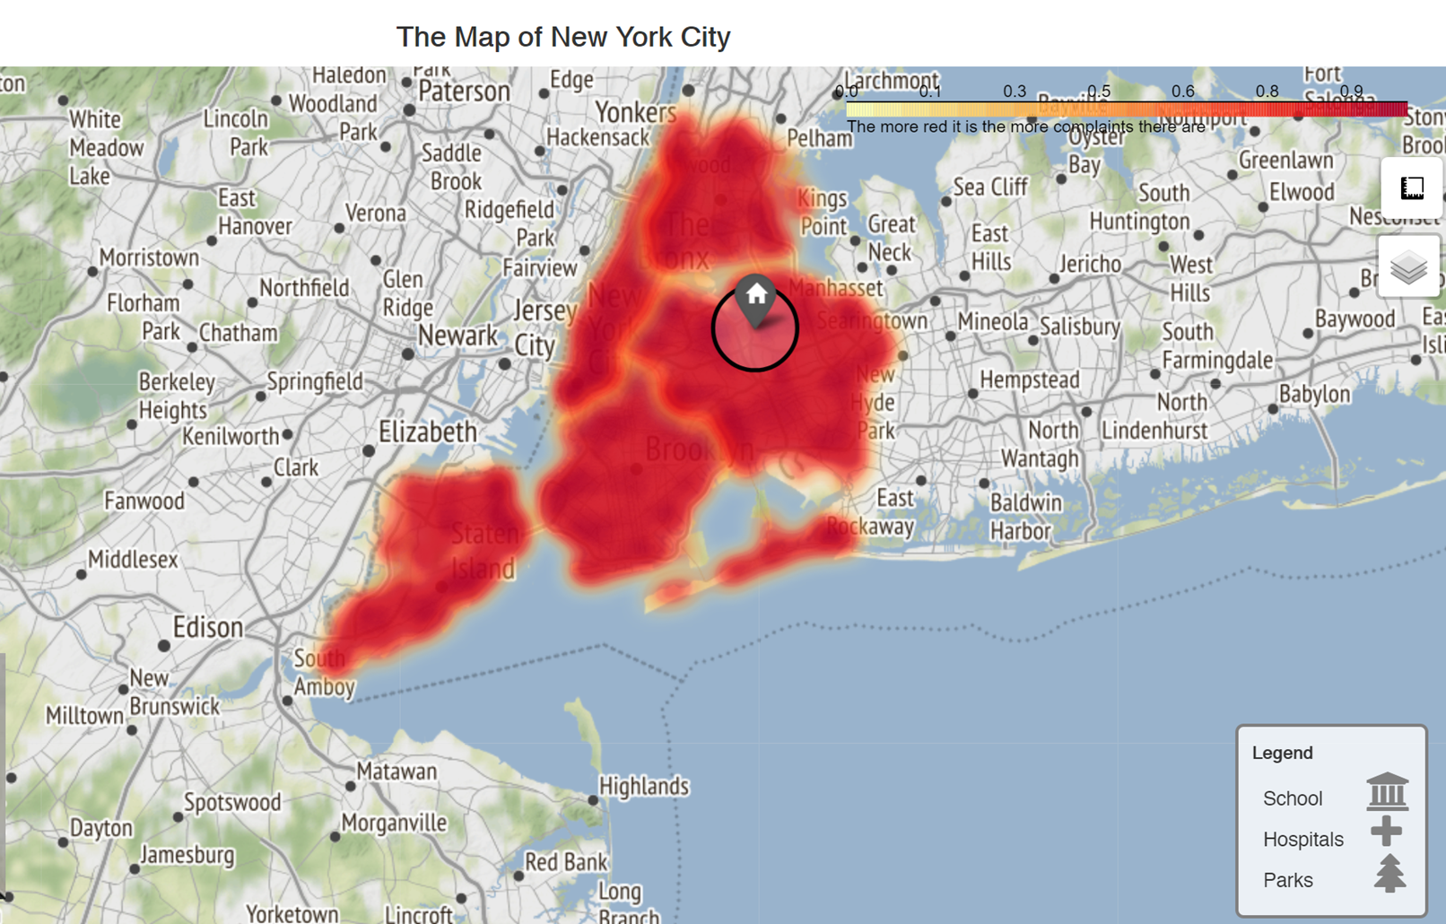
MAPPING IT ALL OUT
Our interactive heatmap can overlay all your search criteria: here is a demo!

Slide 10
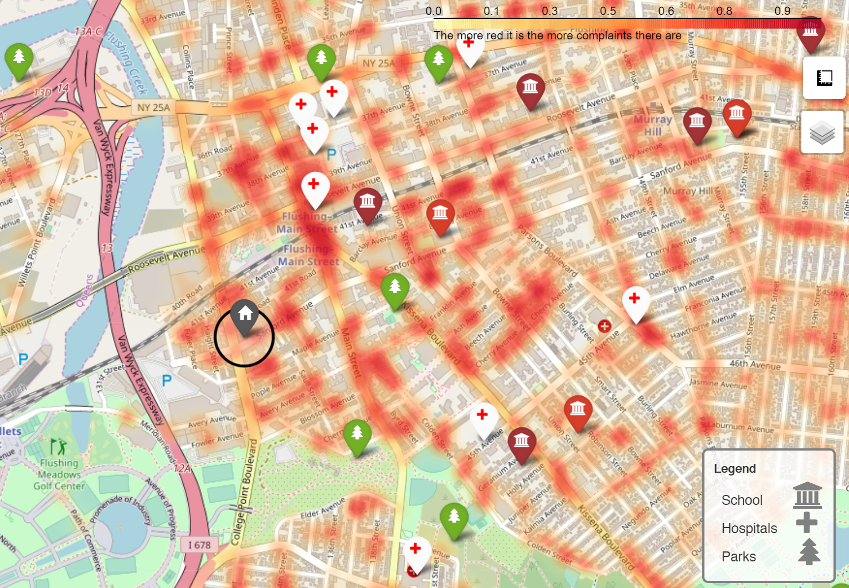
MAPPING IT ALL OUT
Our interactive heatmap can overlay all your search criteria: here is a demo!

Slide 11
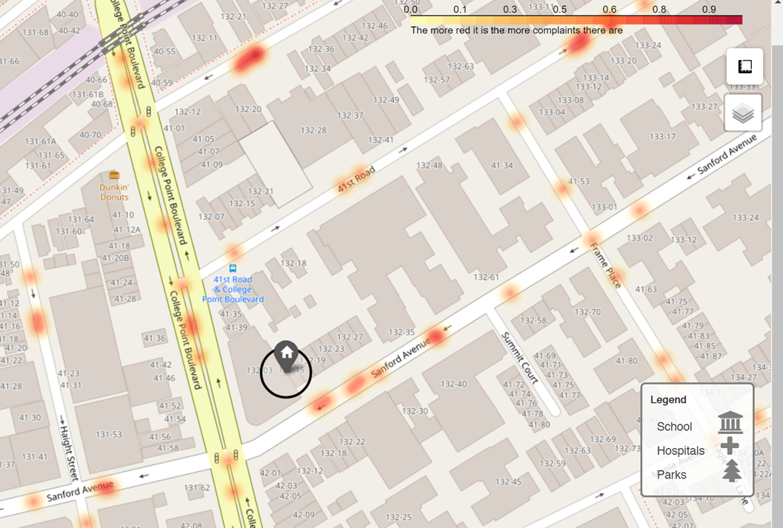
MAPPING IT ALL OUT
Our interactive heatmap can overlay all your search criteria: here is a demo!

Slide 12
The big reveal
Here is what we have for you!

Slide 13

Your new Condo!
Notes:
Hospital distance: < 0.5 miles 5 min walk
Park distance: <1 mile 10 min walk
School distance: 0.5 miles 6 min walk

Slide 14


13240 Sanford Ave APT 3H, Flushing, NY 11355
TRADITIONAL
Non-Traditional
Price range: $700k
Location: Queens
House or Apartment: Condo
Beds & Baths: 2bd and 1ba (min)
Other needs:
Near a good schools
Near a park
Near emergency services (hospital)
Churches
Quiet neighborhood
Reliable utilities (water & heat)
Enough parking
Nice roads (not many potholes)
Safety
Pedestrian accessibility

Slide 15

Thank you!
WWW.gHOSTBUSTERS311.COM

